Slide 1
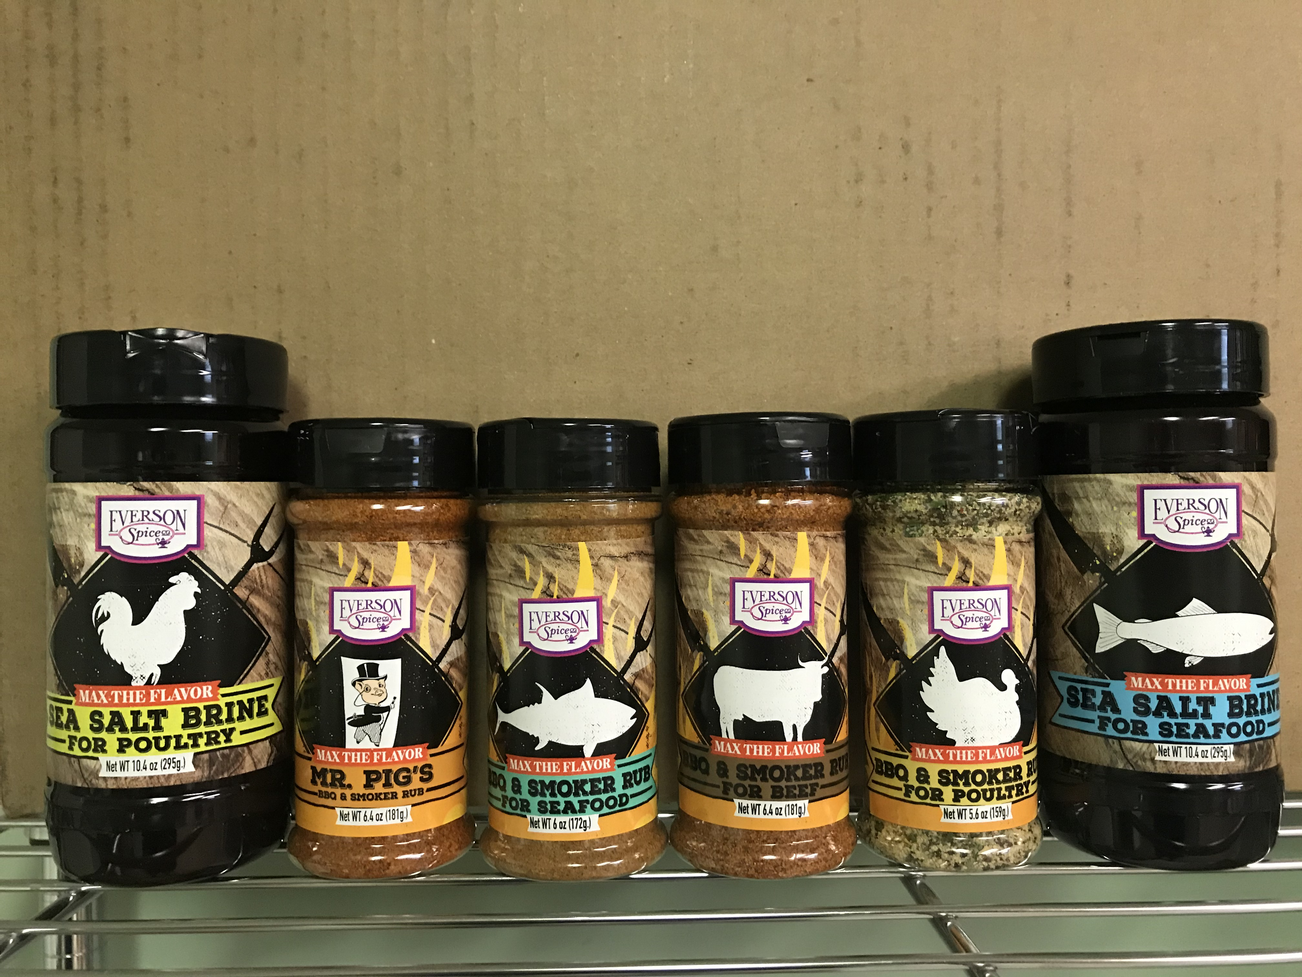
NEW!! RETAIL SMOKER
RUBS AND BRINES
♦ 4 RUBS & 2 BRINES
♦ Protein Specific Profiles to Maximize Flavor
♦ Blends for Beef, Pork, Poultry and Seafood
♦ All Products Priced for Uniform Unit Retails
CODE | PRODUCT | PACK | CASE UPC
101-334 A | BBQ & Smoker Rub for BEEF | 12/6.4 OZ. | 0073020102843-4
101-335 A | BBQ & Smoker Rub for PORK | 12/6.4 OZ. | 0073020102844-1
101-336 A | BBQ & Smoker Rub for POULTRY | 12/5.6 OZ. | 0073020102845-8
101-337 A | BBQ & Smoker Rub for SEAFOOD | 12/6 OZ. | 0073020102846-5
101-338 A | Sea Salt Brine for POULTRY | 6/10.4 OZ. | 0073020102847-2
101-339 A | Sea Salt Brine for SEAFOOD | 6/10.4 OZ. | 0073020102848-9
UNIT UPC
0073020102837-3
0073020102835-9
0073020102834-2
0073020102836-6
0073020102839-7
0073020102838-0
Questions ? - Contact your Everson Broker or call Customer Service
Customerservice@eversonspice.com 562-988-1223
Everson Spice Company 2667 Gundry Ave. Signal Hill, CA 90755

